Slide 1
University of Basrah
AL-Zahraa College of Medicine
Ministry of higher Education and Scientific Research
Cardiorespiratory Care Block
Lecture title: pleual disease and chest wall disease
Date: 9/2/2022
Dr. Mohammed Adil
CRC Block Staff:
Dr Firas Rashid Sayil (block leader)
Dr. Mohammed Adil
Dr Assad Hassan
Dr Ahmed Qassim
Dr Safa Asaad
Dr Mustafa Ghazi
Dr Ilham Mohammed
Dr Zainab Muzahim
Dr. Ahmed Bader
Dr Nawal Mustafa
Dr Zainab Almnaseer
Dr Farqad Alhamdani
Dr Ban M. Saleh
Dr Amani Namaa
References as in the workbook and classroom.
For more detailed instruction, any question, cases need help please contact block leader at the CRC Google classroom or email.

Slide 2
University of Basra
AL-Zahraa College of Medicine
Ministry of higher Education and Scientific Research
Pneumothorax:
Pneumothorax is the presence of air in the pleural space, which can either occur spontaneously, or result from iatrogenic injury or trauma to the lung or chest wall.
Primary spontaneous pneumothorax occurs in patients with no history of lung disease.
Smoking, tall stature and the presence of apical sub pleural blebs are risk factors.
Secondary pneumothorax affects patients with pre-existing lung disease and is associated with higher mortality rates.

Slide 3
University of Basra
AL-Zahraa College of Medicine
Ministry of higher Education and Scientific Research
Where the communication between the airway and the pleural space seals off as the lung deflates and does not re-open, the pneumothorax is referred to as ‘closed’.
The mean pleural pressure remains negative, spontaneous reabsorption of air and re-expansion of the lung occur over a few days or weeks, and infection is uncommon.
This contrasts with an ‘open’ pneumothorax, where the communication fails to seal and air continues to pass freely between the bronchial tree and pleural Space (Broncho pleural fistula).

Slide 4
University of Basra
AL-Zahraa College of Medicine
Ministry of higher Education and Scientific Research
Occasionally, the communication between the airway and the pleural space acts as a one-way valve, allowing air to enter the pleural space during inspiration but not to escape on expiration.
This is a tension pneumothorax. Large amounts of trapped air accumulate progressively in the pleural space and the intrapleural pressure rises to well above atmospheric levels. This causes mediastinal displacement towards the opposite side, with compression of the opposite normal lung and impairment of systemic venous return, causing cardiovascular compromise

Slide 5
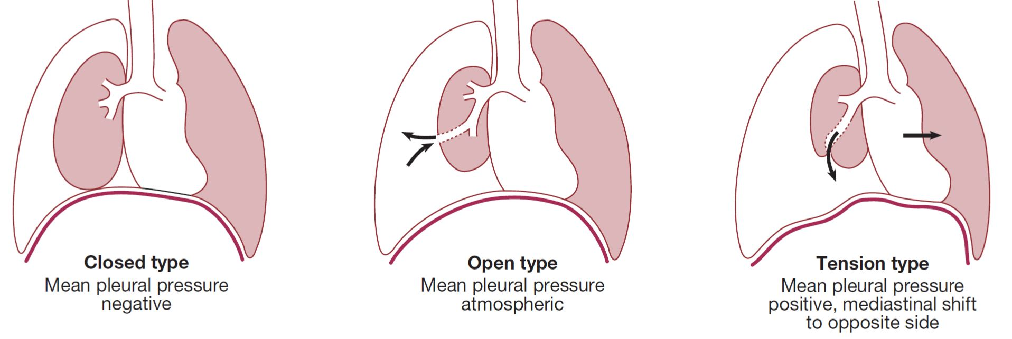
University of Basra
AL-Zahraa College of Medicine
Ministry of higher Education and Scientific Research

Slide 6
University of Basra
AL-Zahraa College of Medicine
Ministry of higher Education and Scientific Research
Clinical features:
The most common symptoms are sudden-onset unilateral pleuritic chest pain or breathlessness.
In those individuals with underlying lung disease, breathlessness can be severe and may not resolve spontaneously.
In patients with a small pneumothorax, physical examination may be normal.
A larger pneumothorax (> 15% of the hemi thorax) results in decreased or absent breath sounds.
The combination of absent breath sounds and a resonant percussion note is diagnostic of pneumothorax.

Slide 7
University of Basra
AL-Zahraa College of Medicine
Ministry of higher Education and Scientific Research
By contrast, in tension pneumothorax there is rapidly progressive breathlessness associated with a marked tachycardia, hypotension, cyanosis and tracheal displacement away from the side of the silent hemi thorax.
Occasionally, tension pneumothorax may occur without mediastinal shift, if malignant disease or scarring has splinted the mediastinum.

Slide 8
University of Basra
AL-Zahraa College of Medicine
Ministry of higher Education and Scientific Research
Investigations:
The chest X-ray shows the sharply defined edge of the deflated lung with complete translucency (no lung markings) between this and the chest wall.
CT is used in difficult cases to avoid misdirected attempts at aspiration.
X-rays may also show the extent of any mediastinal displacement and reveal any pleural fluid or underlying pulmonary disease.

Slide 9
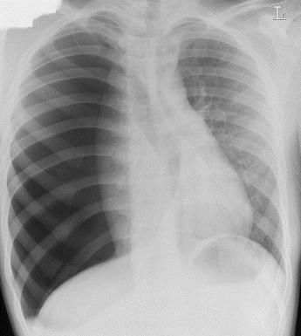
University of Basra
AL-Zahraa College of Medicine
Ministry of higher Education and Scientific Research

Slide 10
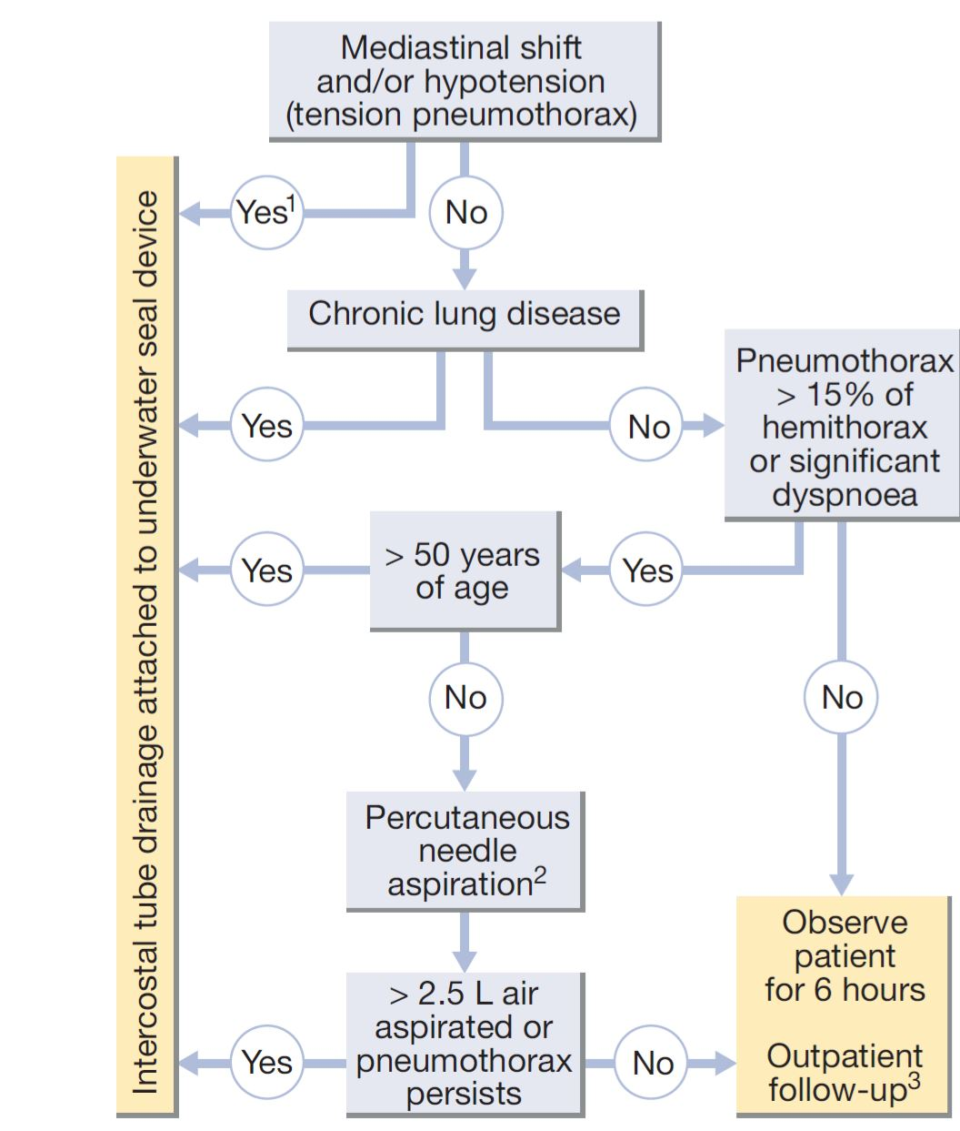
University of Basra
AL-Zahraa College of Medicine
Ministry of higher Education and Scientific Research

Slide 11
University of Basra
AL-Zahraa College of Medicine
Ministry of higher Education and Scientific Research
Pleural effusion:
The accumulation of serous fluid within the pleural space is termed pleural effusion.
The accumulation of frank pus is termed empyema,that of blood is haemothorax, and that of chyle is a chylothorax.
In general, pleural fluid accumulates as a result of either increased hydrostatic pressure or decreased osmotic pressure (‘transudative’ effusion, as seen in cardiac, liver or renal failure), or from increased microvascular pressure due to disease of the pleura or injury in the adjacent lung (‘exudative’ effusion).

Slide 12
University of Basra
AL-Zahraa College of Medicine
Ministry of higher Education and Scientific Research
Clinical assessment
Symptoms and signs??

Slide 13
University of Basra
AL-Zahraa College of Medicine
Ministry of higher Education and Scientific Research
Investigations:
Radiological investigations
The classical appearance of pleural fluid on the erect PA chest film is of a curved shadow at the lung base, blunting the costo phrenic angle and ascending towards the axilla.
Around 200 mL of fluid is required in order for it to be detectable on a PA chest X-ray.
Previous scarring or adhesions in the pleural space can cause localised effusions.
Pleural fluid localised below the lower lobe (‘subpulmonary effusion’) simulates an elevated hemidiaphragm.
Pleural fluid localised within an oblique fissure may produce a rounded opacity that may be mistaken for a tumour.

Slide 14
University of Basra
AL-Zahraa College of Medicine
Ministry of higher Education and Scientific Research
Ultrasound is more accurate than plain chest X-ray for determining the presence of fluid.
A clear hypoechoic space is consistent with a transudate and the presence of moving, floating densities suggests an exudate.
The presence of septation most likely indicates an evolving empyema or resolving haemothorax.
CT scanning is indicated where malignant disease is suspected.

Slide 15
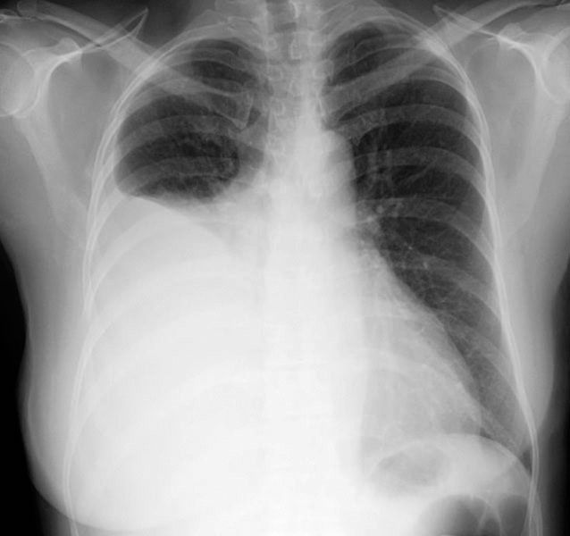
University of Basra
AL-Zahraa College of Medicine
Ministry of higher Education and Scientific Research

Slide 16
University of Basra
AL-Zahraa College of Medicine
Ministry of higher Education and Scientific Research
Pleural aspiration and biopsy
In some conditions (e.g. left ventricular failure), it should not be necessary to sample fluid unless atypical features are present.
appropriate treatment should be administered and the effusion re-evaluated.
In most other circumstances, however, diagnostic sampling is required. Simple aspiration provides information on the colour and texture of fluid and these alone may immediately suggest an empyema or chylothorax. The presence of blood is consistent with pulmonary infarction or malignancy but may result from a traumatic tap.

Slide 17
University of Basra
AL-Zahraa College of Medicine
Ministry of higher Education and Scientific Research
Biochemical analysis allows classification into ) and Gram stain may suggest Para pneumonic effusion.
The predominant cell type provides useful information and cytological examination is essential.
A low pH suggests infection but may also be seen in rheumatoid arthritis, ruptured oesophagus or advanced malignancy.
Ultrasound- or CT-guided pleural biopsy provides tissue for pathological and microbiological analysis.
Where necessary, video-assisted thoracoscopy allows visualisation of the pleura and direct guidance of a biopsy.

Slide 18
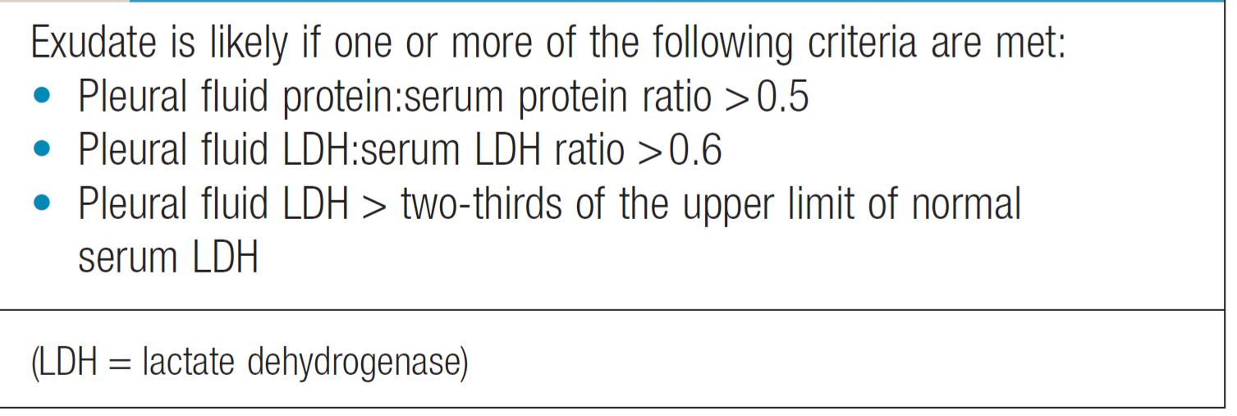
University of Basra
AL-Zahraa College of Medicine
Ministry of higher Education and Scientific Research
Light criteria for pleural effusion:

Slide 19
University of Basra
AL-Zahraa College of Medicine
Ministry of higher Education and Scientific Research
Management:
Therapeutic aspiration may be required to palliate breathlessness but removing more than 1.5 L at a time is associated with a small risk of re-expansion pulmonary oedema.
An effusion should never be drained to dryness before establishing a diagnosis, as biopsy may be precluded until further fluid accumulates.
Treatment of the underlying cause – e.g. heart failure, pneumonia, pulmonary embolism or subphrenic abscess – will often be followed by resolution of the effusion. The management of pleural effusion in pneumonia, tuberculosis and malignancy is dealt with below.

Slide 20
University of Basra
AL-Zahraa College of Medicine
Ministry of higher Education and Scientific Research
Empyema
This is a collection of pus in the pleural space, which may be as thin as serous fluid or so thick that it is impossible to aspirate, even through a wide-bore needle.
Microscopically, neutrophil leucocytes are present in large numbers.
An empyema may involve the whole pleural space or only part of it (‘loculated’ or ‘encysted’ empyema) and is usually unilateral.
It is always secondary to infection in a neighbouring structure, usually the lung, most commonly due to the bacterial pneumonias and tuberculosis.

Slide 21
University of Basra
AL-Zahraa College of Medicine
Ministry of higher Education and Scientific Research
Clinical assessment:
An empyema should be suspected in patients with pulmonary
infection if there is severe pleuritic chest pain or persisting or
recurrent pyrexia, despite appropriate antibiotic treatment.
In other cases, the primary infection may be so mild that it passes unrecognised and the first definite clinical features are due to the empyema itself. Once an empyema has developed, systemic features are prominent

Slide 22
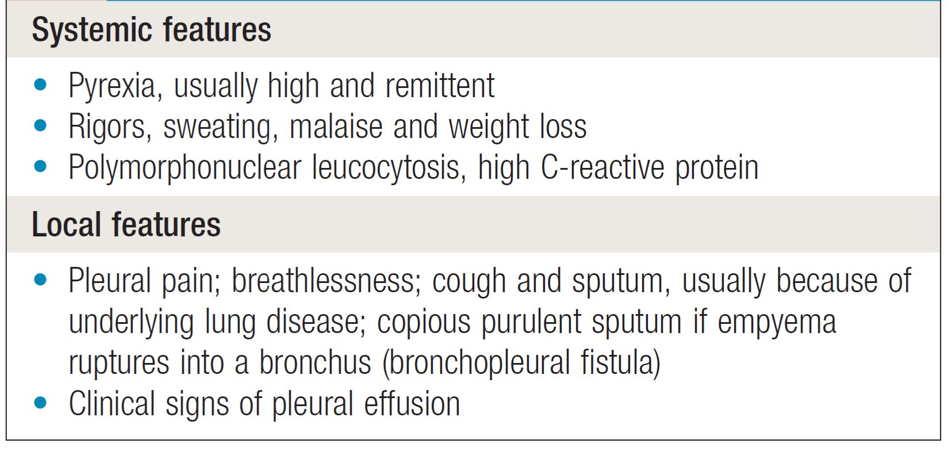
University of Basra
AL-Zahraa College of Medicine
Ministry of higher Education and Scientific Research

Slide 23
University of Basra
AL-Zahraa College of Medicine
Ministry of higher Education and Scientific Research
Investigations
Chest X-ray appearances may be indistinguishable from those of pleural effusion, although pleural adhesions may confine the empyema to form a ‘D’-shaped shadow against the inside of the chest wall).
When air is present as well as pus (pyopneumothorax), a horizontal ‘fluid level’ marks the air/liquid interface.
Ultrasound shows the position of the fluid, the extent of pleural thickening and whether fluid is in a single collection or multiloculated, containing fibrin and debris

Slide 24
University of Basra
AL-Zahraa College of Medicine
Ministry of higher Education and Scientific Research
Ultrasound or CT is used to identify the optimal site for aspiration, which is best performed using a wide-bore needle.
If the fluid is thick and turbid pus, empyema is confirmed.
Other features suggesting empyema are:
fluid glucose of less than 3.3 mmol/L (60 mg/dL).
lactate dehydrogenase (LDH) of more than 1000 IU/L.
fluid pH of less than 7.0 (H+ > 100 nmol/L).
The distinction between tuberculous and non-tuberculous disease can be difficult and may require pleural biopsy, histology, culture and/or a NAAT.

Slide 25
University of Basra
AL-Zahraa College of Medicine
Ministry of higher Education and Scientific Research
Management
An empyema will heal only if infection is eradicated and the empyema space is obliterated, allowing apposition of the visceral and parietal pleural layers.
If the initial aspirate reveals turbid fluid or frank pus, or if loculations are seen on ultrasound, the tube should be put on suction (−5 to −10 cmH2O) and flushed regularly with 20 mL normal saline.
If the organism causing the empyema can be identified, the appropriate antibiotic should be given for 2–4 weeks.
Empirical antibiotic treatment (e.g. intravenous co-amoxiclav or cefuroxime with metronidazole) should be used if the organism is unknown.
Intrapleural fibrinolytic therapy is of no benefit.

Slide 26
University of Basra
AL-Zahraa College of Medicine
Ministry of higher Education and Scientific Research
Disorders of the diaphragm
Congenital disorders
Diaphragmatic hernias
Congenital defects of the diaphragm can allow herniation of abdominal viscera. Posteriorly situated hernias through the foramen of Bochdalek are more common than anterior hernias through the foramen of Morgagni.
Eventration of the diaphragm
Abnormal elevation or bulging of one hemidiaphragm, more often the left, results from total or partial absence of muscular development of the septum transversum. Most eventrations are asymptomatic and are detected by chance on X-ray in adult life
but severe respiratory distress can be caused in infancy if the diaphragmatic muscular defect is extensive.

Slide 27
University of Basra
AL-Zahraa College of Medicine
Ministry of higher Education and Scientific Research
Acquired disorders
Elevation of a hemidiaphragm may result from paralysis or
other structural causes.
The phrenic nerve may be damaged by lung cancer, disease of cervical vertebrae, tumours of the cervical cord, shingles, trauma (including road traffic and birth injuries), surgery, and stretching of the nerve by mediastinal masses and aortic aneurysms.
Idiopathic diaphragmatic paralysis occasionally occurs in otherwise fit patients.
Paralysis of one hemidiaphragm results in loss of around 20% of ventilator capacity but may not be noticed by otherwise healthy individuals.
Bilateral diaphragmatic weakness occurs in peripheral
neuropathies of any type, including Guillain–Barré syndrome

Slide 28
University of Basra
AL-Zahraa College of Medicine
Ministry of higher Education and Scientific Research
Deformities of the chest wall
Thoracic kyphoscoliosis
Abnormalities of alignment of the dorsal spine and their consequent
effects on thoracic shape may be caused by:
• congenital abnormality
• vertebral disease, including tuberculosis, osteoporosis and
ankylosing spondylitis
• trauma
• neuromuscular disease, such as poliomyelitis.

Slide 29
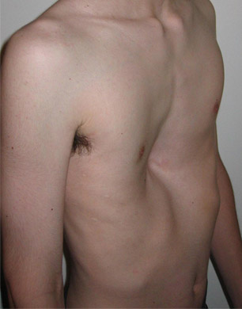
University of Basra
AL-Zahraa College of Medicine
Ministry of higher Education and Scientific Research
Pectus excavatum
Pectus carinatum

Slide 30
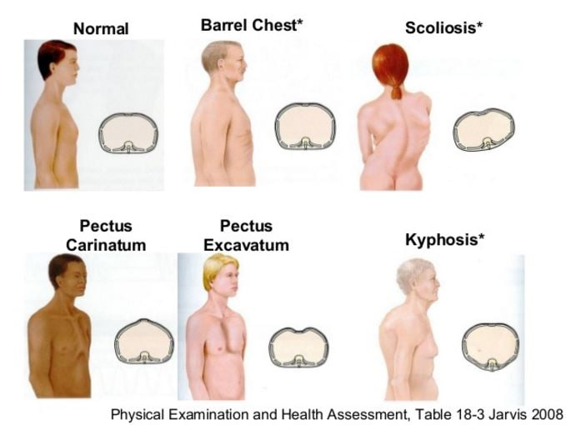
University of Basra
AL-Zahraa College of Medicine
Ministry of higher Education and Scientific Research

Slide 31
University of Basra
AL-Zahraa College of Medicine
Ministry of higher Education and Scientific Research
Thank you

